Slide 1


Malnad College of Engineering, Hassan – 573 202, Karnataka (An Autonomous Institution under VTU, Belagavi)
Technical Seminar on
“ Certificate Authentication using Blockchain ”
Presented by: Under the Guidance of
Name : Thejaswini B S Dr Nanditha B R
USN : 4MC20IS057 (Assistant Professor)

Slide 2
CONTENTS
Introduction
Literature Review
Challenges in traditional authentication
Why Blockchain for Authentication
Proposed Model
How it works
Applications
Conclusion

Slide 3

INTRODUCTION
Certificate authentication is a process that validates the identity of entities in a network. It uses digital certificates to establish trust.

Slide 4
LITERATURE REVIEW
Sl. No. | References | Observations
01 | G. Balamurugan and K. K. A. Sahayaraj, "A Blockchain Based Certificate Authentication System," 2023 International Conference on Computer Communication and Informatics (ICCCI), Coimbatore, India, 2023 | demonstrating its effectiveness in providing tamper-proof, decentralized, and transparent verification of academic certificates.
02 | Shivani Pathak, Vimal Gupta, Nitima Malsa, Ankush Ghosh & R. N. Shaw, "Blockchain-Based Academic Certificate Verification System—A Review", International Conference paper August 2022 | highlighting its potential to enhance security, transparency, and efficiency in academic credential verification processes.

Slide 5
LITERATURE REVIEW
Continued….
Sl. No. | References | Observations
03 | C.Rashmi, G. Archana, K. Rashmika, K. Spandana, Ch. Manasa., “A Blockchain Based Secure And Efficient Validation System For Digital Certificates”, 2023, v14i03.14172 | presents significant potential in combating certificate forgery through decentralized, tamper-resistant
04 | Md. Mijanur Rahman, Md. Tanzinul Kabir Tonmoy, Saifur Rahman Shihab, Riya Farhana, “Blockchain-Based Certificate Authentication System with Enabling Correction”, Journal of Computer and Communications, Volume 11, Issue 3 (March 2023) | not only addresses challenges posed by certificate fabrication through advanced validation methods but also offers the unique capability to generate and rectify certificates, ensuring integrity and trustworthiness, with potential expansions to include professional degree management and National Identity Card verification systems

Slide 6




CHALLENGES IN TRADITIONAL AUTHENTICATION
Security Risks
Certificate Revocation
Scalability

Slide 7





WHY BLOCKCHAIN FOR AUTHENTICATION
Decentralization
Immutable
Transparency
Scalable
Efficiency

Slide 8
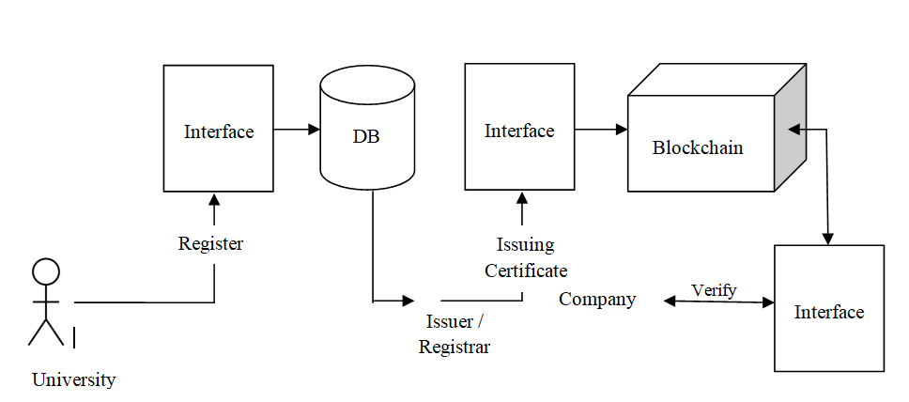
PROPOSED MODEL FOR DIGITAL CERTIFICATE

Slide 9
HOW IT WORKS ?
1
Generating Certificate
2
Hashing
3
Blockchain
Verification
4
Certificate
Verification

Slide 10



STEP 1 : Generating Certificate
Authority
Request
Generate
Student
Certificate
Transmit

Slide 11
STEP 1 : Generating Certificate
Continued….
Pseudocde 1 : Function to generate certificate
function to generate certificate (Arguments)
public {
checks if authorized to generate
then checks if student identity is verified
then generate certificate
store and transmit it
else
return back
}

Slide 12
STEP 2 : Hashing
1. Input
Block of Address of Certificate (any length)
2. Padding
Block of Address of Certificate (any length)
1 000....
To make it multiple of 512 bits
3. Initialization
4. Message Schedule
1010
1110
0111
0110
0101
1011
….

Slide 13
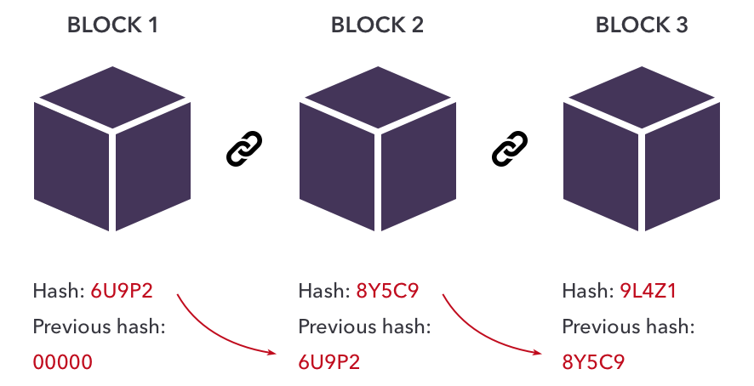
STEP 2 : Hashing
Continued….
5. Compression Function

Slide 14
STEP 2 : Hashing
Continued….
6. Finalization
Hash Fingerprint (ex: 10e6c7) or QR Code

Slide 15



STEP 3 : Blockchain Verification
Recording on Blockchain
Obtained hash value is write on a special ledger called Blockchain
Immutable Record
Once something is written on the blockchain it stays forever.
Ensuring Integrity
The chain ensures that if anyone tries to change something in the middle, it would clear to everyone

Slide 16
STEP 4 : Certificate Verification
Retrieving the certificate’s hash value from Blockchain
Computing the hash of Received Certificate
Comparing the hashes
Detecting tampering

Slide 17
STEP 4 : Certificate Verification
Continued….
Pseudocde 2 : Function to Authenticate
function to Authenticate (Arguments)
public {
checks if exists on the blockchain
then checks if computed and on chain hash are match
then return "Certificate is authenticated "
else return "Certificate is tampered "
else return "Certificate does not exist"
}

Slide 18




EXAMPLE : Academic Certificate Verification
Issue Certificate
Sends Hash key to Student
University
Sends their
Credentials to
Company
Request
Blockchain and Hash function
Student
Verify
Company

Slide 19


APPLICATIONS
1. Academic Credentials Verification
Academic credentials verification using blockchain in certificate authentication ensures tamper-proof records of educational achievements, fostering trust and integrity in credential verification processes.
2. Professional Certifications
Professional certifications can be authenticated using blockchain technology, ensuring tamper-proof verification and enhancing the trustworthiness of credentials.

Slide 20



APPLICATIONS
3. Supply Chain and Product Authentication
Supply chain management ensures efficient flow of goods/services from origin to consumption, while product authentication verifies item legitimacy, safeguarding against counterfeiting and ensuring quality assurance.
4. Healthcare Records Management
In healthcare records management, blockchain can be applied for certificate authentication, ensuring the integrity and authenticity of medical certifications through immutable and transparent verification processes.
5. IoT Device Authentication
IoT device authentication enhances certificate authentication using blockchain by securely verifying the identity and integrity of IoT devices accessing or transmitting data within the blockchain network.

Slide 21
CONCLUSION
In conclusion, certificate authentication using blockchain offers a secure, transparent, and tamper -resistant solution that enhances trust and integrity in digital certificates across diverse industries and applications.

Slide 22
Thank You

